Slide 1


THREAT MATRIX
PRESENTATION
Introducing ThreatMatrix, your advanced cybersecurity companion designed to forecast and mitigate potential threats in real-time. With its cutting-edge technology and user-centric design, ThreatMatrix empowers businesses to stay ahead of cyber attacks and ensure better control over their security posture.

Slide 2


INTRODUCTION
In today's digital landscape, the threat of cyber attacks looms large over businesses, organizations, and individuals alike. With the increasing complexity and frequency of cyber threats, it has become imperative to develop proactive measures to anticipate, mitigate, and respond to potential attacks. To address this pressing need, our project aims to leverage advanced data analysis techniques, including clustering, Tableau visualization, and heat maps, to predict future cyber threats and their potential impact on firms.The heart of our project lies in the development of a dynamic and scalable system that can efficiently process, analyze, and visualize disparate data sets. Through the integration of clustering algorithms, we aim to identify common factors and characteristics among past cyber attacks, allowing us to group similar incidents and extrapolate potential future threats. Additionally, the use of Tableau visualization tools will enable us to create interactive dashboards

Slide 3
PROBLEM STATEMENT AND FEATURES
Analyze the current and historical data which is available publicly and predict future Threats or Cyber Attacks and impact on any firm using web scrapping.
Flexible Data Integration: ThreatMatrix is not bound by rigid data formatting constraints. It seamlessly integrates with multiple data sources, allowing for comprehensive analysis and threat detection.
Scalable Solution: Built to scale, ThreatMatrix can handle vast amounts of data, ensuring that it remains effective even as your organization grows.
Enhanced User Experience: Our Tableau-powered reporting solution provides a streamlined user experience, allowing users to filter across datasets with ease and gain valuable insights at a glance.
Forecasting Dashboard: Gain actionable insights with ThreatMatrix's forecasting dashboard, which accurately predicts cyber threats based on publicly available data. With the right filters in place, users can anticipate potential risks and take proactive measures to mitigate them.
Mitigation Techniques: When a known threat is detected, ThreatMatrix goes beyond mere identification by offering mitigation techniques sourced from online resources. This empowers users to respond effectively to cyber threats and fortify their defenses.
Advanced ML Algorithms: With Linear Regression and CNN Model, ThreatMatrix leverages machine learning algorithms to learn patterns and relationships in cyber threat data. This enables the platform to make predictions and decisions autonomously, without the need for explicit training for each scenario.
Benefits: By leveraging ThreatMatrix, businesses can make informed decisions and implement better controls against potential threats and attacks. This proactive approach not only enhances security but also ensures that businesses are future-ready in an increasingly volatile cyber landscape.

Slide 4
EXECUTION PLAN
Project Scope and Requirements Gathering:
Define the scope of the project, including specific objectives, deliverables, and timelines.
Gather requirements from stakeholders regarding the functionalities and features of the cyber threat detection dashboard.
Data Collection and Preprocessing:
Identify and collect relevant data sources, including historical cyber attack data, open-source threat intelligence feeds, and contextual information such as holidays and public events.
Preprocess the collected data to clean, normalize, and transform it into a suitable format for analysis. This may involve data cleaning, feature engineering, and merging multiple data sources.
Clustering Analysis:
Utilize Python libraries such as Pandas, NumPy, and scikit-learn to perform clustering analysis on the preprocessed data.
Apply clustering algorithms such as K-means or hierarchical clustering to identify patterns and similarities among past cyber attacks.
Tableau Visualization:
Export the preprocessed data to CSV files for visualization in Tableau.
Develop interactive dashboards using Tableau Desktop, incorporating visualizations such as bar charts, line graphs, and scatter plots to represent clustering results, trends, and correlations.
Customize the dashboard layout and design using HTML and CSS to enhance user experience and aesthetic appeal.
Heat Map Generation:
Utilize Python libraries such as Matplotlib or Seaborn to generate heat maps based on geographical distribution of cyber attacks.
Integrate heat maps into the Tableau dashboard to provide visual representation of regional risk levels and hotspots.
HTML and CSS Integration:
Develop HTML templates for the dashboard layout, incorporating placeholders for Tableau visualizations and interactive elements.
In addition to clustering algorithms and Tableau visualization, ThreatMatrix Analytics incorporates linear regression and Convolutional Neural Network (CNN) models to further enhance its predictive capabilities.

Slide 5
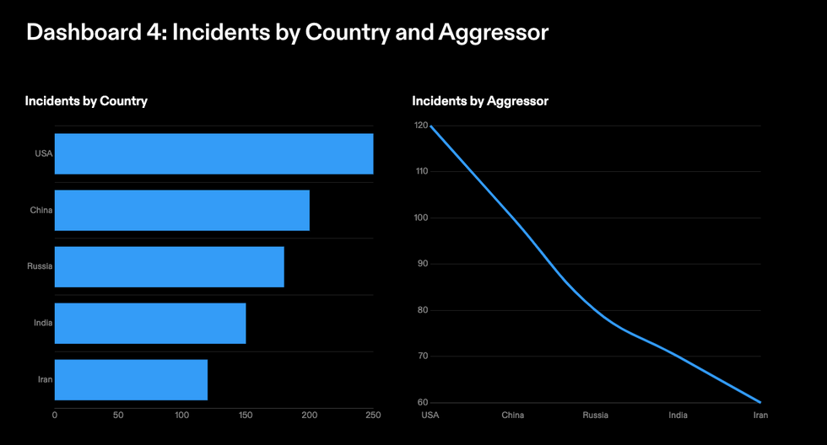
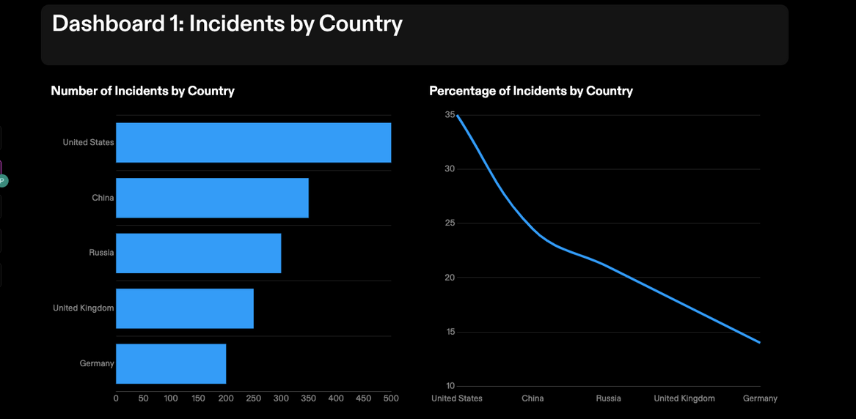
OVERVIEW
UNIFIED VIEW
CYBER THREATS INCIDENTS

Slide 6
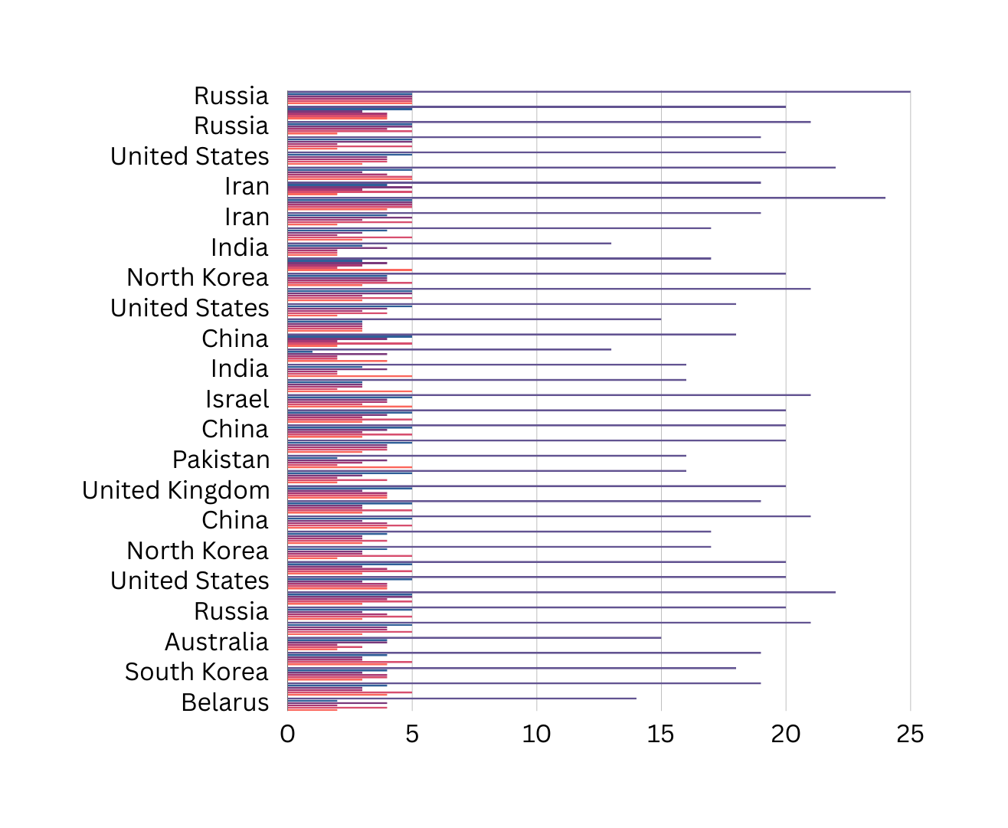
INTERACTIVE
ANAYTICS DASHBOARD

Slide 7




OUR TEAM
ASHFIRE
Connect with our team Members
Pawan kumar
(Team Lead)
Sathvik kuna
Shashank Tumula
Vanshika Gupta

Slide 8

THANK YOU
https://github.com/pawan-cpu/ThreatMatrix-Analytics

